Slide 1

Dev•Ops
Jon Calalang
Cloud/DevOps Engineer
Fork me @jmcalalang

Slide 2
Who is this guy?

Slide 3
Establishing History

Slide 4
Henry Ford
Ford Motor Company
Assembly Line
Flow Line

Slide 5
Taiichi Ohno
Toyota Production System (TPS)
LEAN Manufacturing
Flow Line
Kanban
Just in Time (JIT)

Slide 6
W. Edwards Deming
14 Points for Management
Business Effectiveness
Break down barriers between departments (9)
Cease dependence on inspection to achieve quality (3)
Improve constantly and forever the system of production and service (5)

Slide 7
Eliyahu M. Goldratt
Theory of Constraints (TOC)
System Thinking
Identify the system's constraint(s).
Decide how to exploit the system's constraint(s).
Subordinate everything else to the above decision(s).
Elevate the system's constraint(s).
Warning! If in the previous steps a constraint has been broken, go back to step 1, but do not allow inertia to cause a system's constraint.[4]

Slide 8
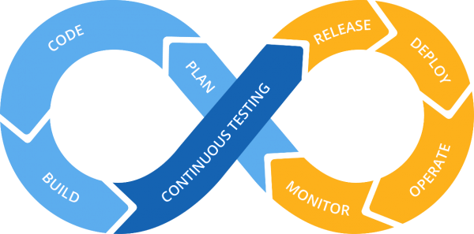
Gene Kim
The Phoenix Project
The Three Ways
System Thinking
Amplify Feedback Loops
Culture Of Continual Experimentation
Culture, Automation, Measurement, and Sharing

Slide 9
Dev
Ops

Slide 10

Dev
Ops
DevOps

Slide 11
Dev
Ops
I Puppet therefore I am
One system to rule them all!
Ruby FTW!
Need. EASY. Button.
Replace Ops with tiny shell scripts…
I CANZ L33T DEV

Slide 12
Dev
Ops
A culture and mindset for collaboration
Communication through relationships
Understanding and participating together throughout the entire service lifecycle
A common, integrated process

Slide 13
Dev
Ops

Slide 14
The Goal – To Deliver Apps
The Team
Common Toolkits
Delivery

Slide 15

Social Coding

Slide 16
GitHub
Source Code Management

Slide 17
Version Control
Repository
Repositories
Forking/Cloning
Branches
Pull Requests

Slide 18
Social Coding
Code Modification Exercise

Slide 19

Infrastructure as Code

Slide 20
Ansible
Automation Platform

Slide 21
Code
Modules
Roles
Playbooks

Slide 22
Deployment
Code Configuration Deployment

Slide 23

Continuous Delivery

Slide 24
Jenkins
Continuous Integration

Slide 25
Orchestration
Projects
Stages
Builds

Slide 26
Delivery
Code Configuration
Delivery

Slide 27

Hidden Bonus ChatOps

Slide 29
Sources
Super NetOps Container(s)
https://github.com/f5devcentral/f5-super-netops-container
Ansible:
https://github.com/jmcalalang/ansible_f5
Jenkins:
https://github.com/jmcalalang/F5file
F5_Chatbot
https://github.com/npearce/f5_chatbot

